Slide 1
HOW TO MAKE A SQUARE ?

Slide 2
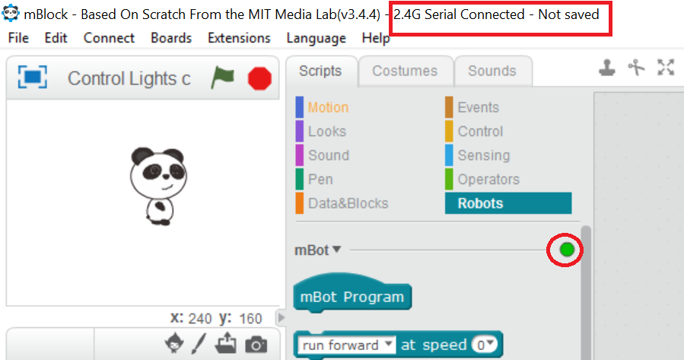
STEP 1.a: Connect your mBot in 2.4G serial mode
Start the mBlock application on your laptop
Select Connect > 2.4G Serial > Connect
The top of the window should look like this !

Slide 3
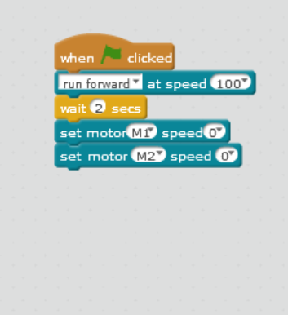
STEP 2a Move your mBot forward
We already know, how to move mBot forward, right ?
To move your mBot you can use “run forward at speed 0”
Change the speed from 0 to 100
And stop the motors after 2 seconds
Now, press the green flag !

Slide 4
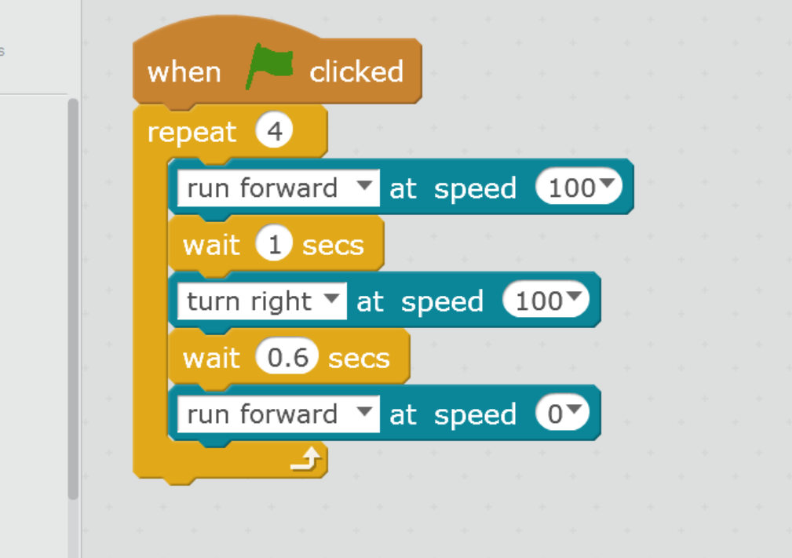
STEP 2a How to turn mBot right/left ?
Use the “run forward at speed 0” block and change the direction to the right for 0.6 secs and now continue moving forward.
Use the repeat 4 to turn four times (Square has 4 sides)
Press the green flag to start moving !!

